Slide 1
Structures and Management of Organizations

Slide 2
Organizational Models
Group of people working in FORMAL way
Rules about who does what
How work is shared
The Bureaucratic Model
Tasks are split into specialist roles and people become expert in these
The performance of each task is governed by rules. No variation in each task, so no issue of coordination
Each individual/unit is accountable to only one manager
Formal interactions employee to employee and employee to customer
Recruitment is based on qualification, employees are protected from arbitrary sacking, promotion is based on seniority and achievement

Slide 3
The Bureaucratic Model
Hierarchical organization
Structure -> Tree
Advantages
Central authority in bureaucracy makes it effective in organizing.
It supports the hiring of specialized officials.
It follows Standard Operating Procedure. – efficiency and predictability
It sets no room for favoritism.
It allows for merit-based hiring and promotion.
It plays an important role in policy making.
Disadvantages
It can hamper achievement of results in time.
It breeds boredom and can affect productivity. –same routine – less productivity
It results to passive and rule-based human beings. (restricts freedom of individual)
It can result to inefficiency. (fixed salary and tasks)

Slide 4
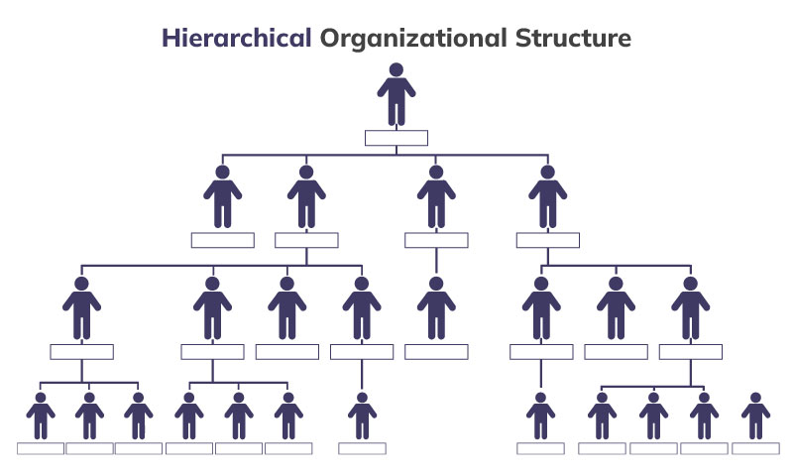
The Bureaucratic Model

Slide 5
Organic (Flat Structure) Model
Organic Model (Likert): “… ensure a maximum probability that in all interactions and in relationships within the organization, each member, in the light of their background, values, desires and expectations, will view the experience as supportive and one which builds a sense of personal worth and importance” – small professional companies
Organic organization model is a structure that is highly adaptive and flexible according to changing environment.
They are more flexible and open.
Tasks and role are less rigidly defined, allowing people to adjust to situational requirements.
Communication is more multidirectional.
Manager’s role is to help employees to achieve their work rather than supervision

Slide 6
Organic Model
Characteristics of Organic Model
Cross Functional teams
Cross hierarchical teams
Free flow of information
Wide span of control
Low formalization
Jobs are less standardized
Fewer rules and regulations
Decentralization of decision
Emphasize on expertise rather than authority
Notes:
When we say that "jobs are less standardized," we are referring to the idea that traditional job roles and tasks are becoming less rigidly defined and more fluid in nature.

Slide 7
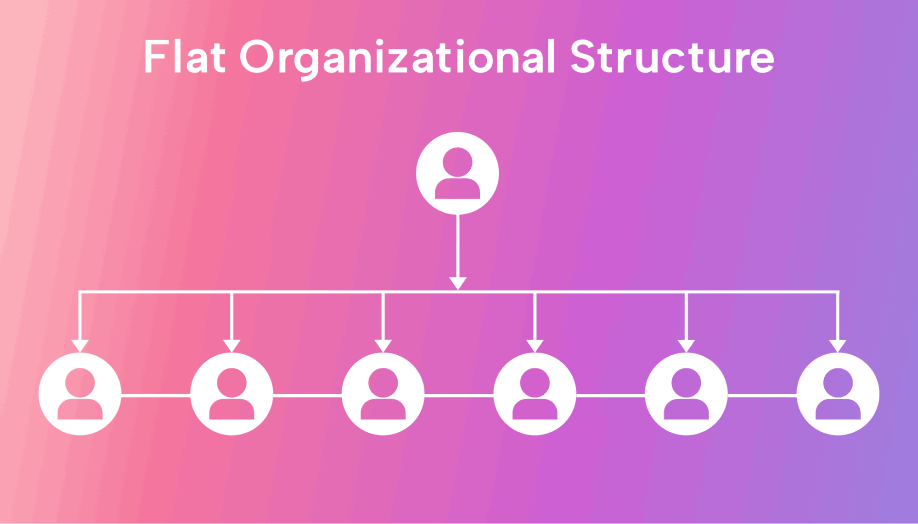
Organic Model
Notes:
When we say that "jobs are less standardized," we are referring to the idea that traditional job roles and tasks are becoming less rigidly defined and more fluid in nature.

Slide 8
Matrix Management
Accepts that bureaucratic model is too restrictive
Work may be project-based
Employees may be working on several projects simultaneously
Employees may answer to several managers at once
Requires rules that will enable possible conflicts to be resolved.
Advantages
1. Combination of Skills and Competencies
2. Collaboration and Cooperation
3. Innovation
4. Flexibility
Disadvantages
1. Potential Loss of Accountability
2. Dual-reporting and Potential Conflicts
2. Dual-reporting and Potential Conflicts
Notes:
More about matrix management: https://gocardless.com/guides/posts/matrix-management/#:~:text=Matrix%20management%20is%20a%20form,both%20functions%20and%20project%20lines.

Slide 9
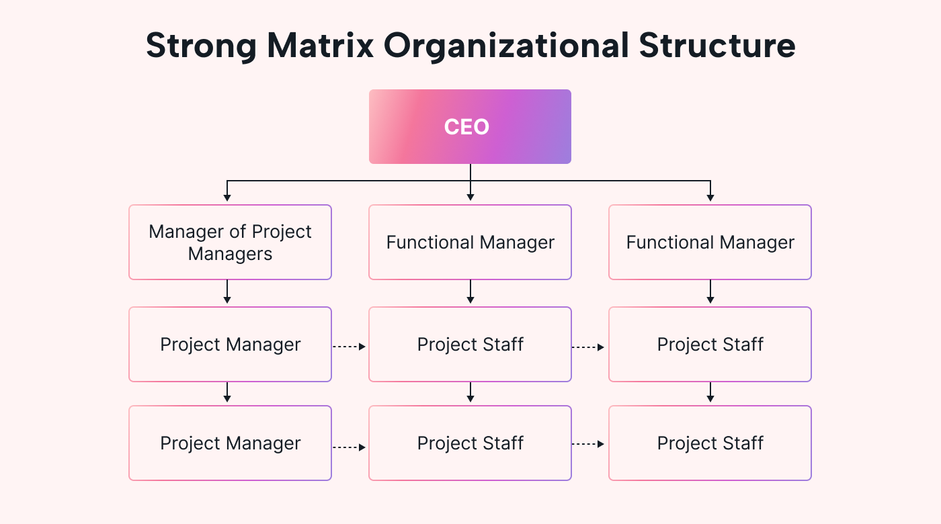
Matrix Management
Notes:
More about matrix management: https://gocardless.com/guides/posts/matrix-management/#:~:text=Matrix%20management%20is%20a%20form,both%20functions%20and%20project%20lines.

Slide 10
Structuring Principles Structure by Function
How to group together activities and tasks
Primary Activities
Operations – Core business
Administration
Pay bills
Hire staff
Sales and Marketing
Research and Development
Different operations in different organizations but administration varies less
Sales and Marketing activity not specific to commercial organizations

Slide 11
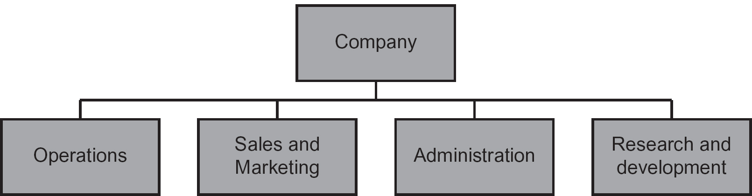
Structuring Principles Structure by Function
Structure based on – Medium Sized Companies
Administrative division
Operations division
Sales and Marketing division
R&D Division

Slide 12
Structuring Principles Structure by Geography
Multinational Companies
Linguistic and Cultural factors
Sales and Marketing locally based
CGI – Big IT services company based in Montreal
Operates in 40 countries
Operations structured into 6 geographically based divisions

Slide 13
Structuring Principles Product Line Structure
Based on different types of products
Motor Vehicle Industry
Cars and light vans
Heavy goods vehicles
Replacement parts
Software for Corporate Customers
Development
Maintenance and Support
Training

Slide 14
Structuring Principles Market Sector
Based on different market sectors to which its customer/prospective customers belong
Popular in IT industry
Sales and Marketing point of view, each division can clearly identify customers
Staff (sales and technical both), familiar with customers problems
Within company, divisions unaware of each other’s expertise
Too much focus on traditional areas, new opportunities missed

Slide 15
Structuring Principles Structure by Technology
Divisions of software companies
AI
Communications
Web-based systems
Real-time systems
Problems
Different technologies to meet customer’s needs
Many software engineers competent in many technologies
Difficult for sales and marketing to predict which possible client need which technology
Not sufficiently customer focused, rather selling the technologies they have

Slide 16
Structuring Principles Operational Structure
Project based organizations
Custom Software
System Integration
R&D can be organized on project basis
Administrative activities also can be organized on project basis
Transferring company’s had office
Project activity normally long, team stays only for the time of the project
Product activity normally short, but teams stays
Motor vehicle manufacturing
Oil refining
Dairy farming
Central data processing
Payroll, accounts etc

Slide 17
Structuring Principles Operational Structure
Product activity normally short, but teams stays
Motor vehicle manufacturing
Oil refining
Dairy farming
Central data processing
Payroll, accounts etc
From employee point of view, activities structured on project base, environment, colleagues and clients constantly changing
In production based, change is slower and gradual

Slide 18
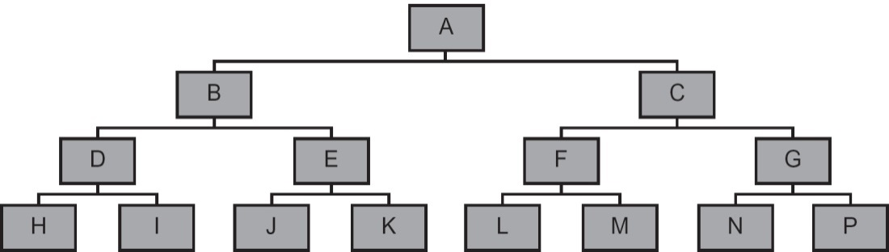
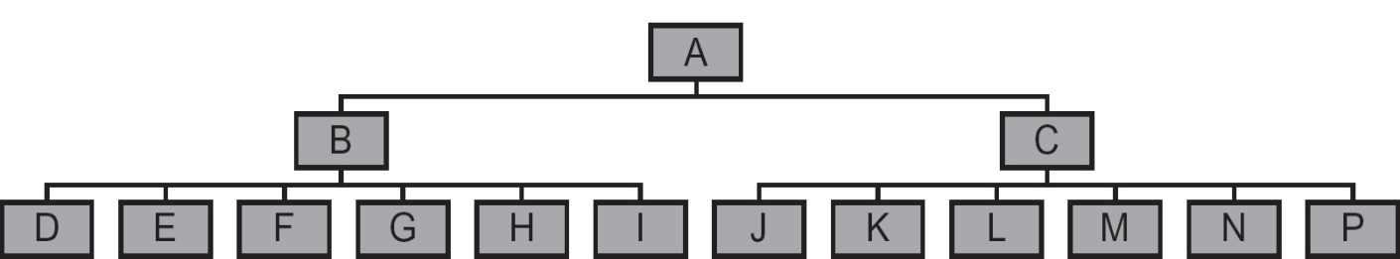
Depth of Structure
Number of layers – Max number of layers
Manager’s Span of Control
Professionals prefer flatter structure

Slide 19
Centralization
Centralized
Maximum power at top
Decentralized
Power and Control at lowest level
Software Company Example ?
Decentralization found in hi-tech companies
Centralization is common in manufacturing company – long-established companies
Flexible Centralization?

Slide 20
Structure in Practice Medium Size Company
Medium size UK based software company
Software development and Consultancy in UK , other European countries
It could go with market sector structure
Each division responsible for sales and marketing and operations
It could also adopt functional structure
With sales and marketing and operations department
All programmers, analysts, designers and project managers in one group and sales and marketing in another group
Easy to organize and good flexibility
Structure sales and marketing according to market sector
Structure within operations division ?
Project based for each contract
Do we group projects by market sector or technical characteristics ?
Maybe both on requirement of importance
Where risks and problems are technical – technology based
Where application considerations are important – market sector
In either case it seems sensible to have finance and administrative department

Slide 21
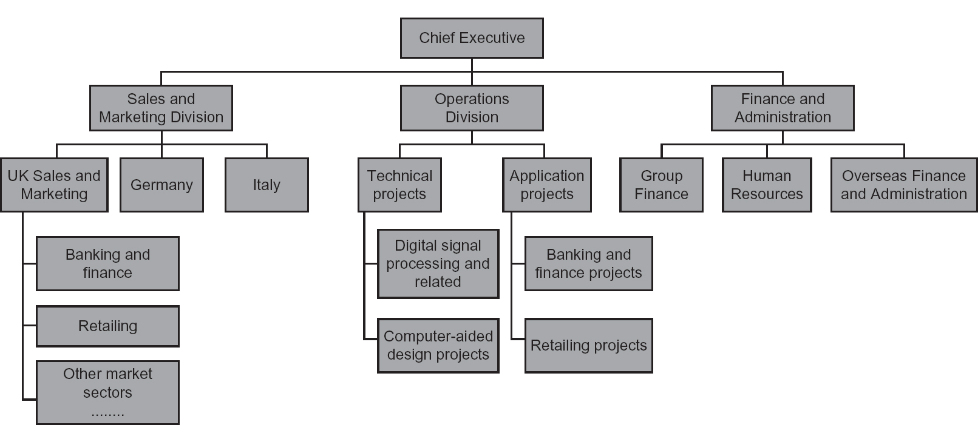
Structure in Practice

Slide 22
Cadbury Schweppes
Functional units: Human Resources, Legal, Finance, Supply Chain, Commercial Strategy and Science and Technology
It also has five operating units that are defined partly in geographical terms and partly in terms of the two major product lines, beverages and confectionery

Slide 23
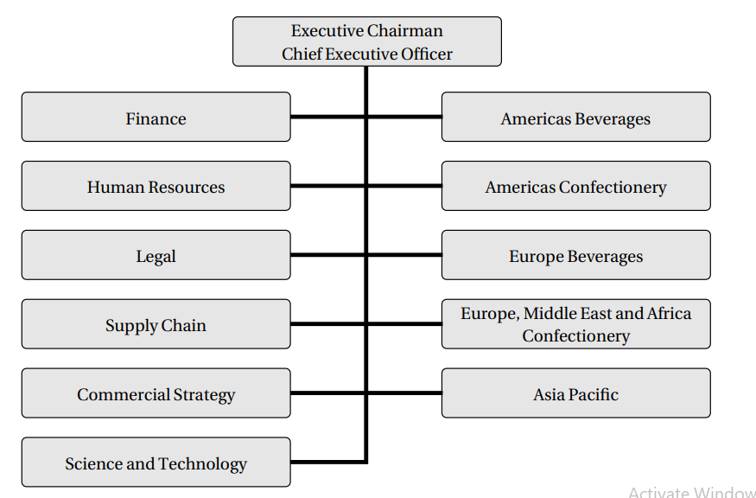
Cadbury Schweppes

Slide 24
Structuring Principles Mixed Structure
Large organizations use mixture of functional, geographical and product line structure
Microsoft based on product line structure
Windows division
Servers and Tools
Online Services division
MSN, Bing, adCenter etc
Microsoft Business division
MS Office etc
Entertainment and Devices division
Xbox, Skype
R&D Separate corporate activity, spread geographically but structured on project base
Support services (HR, Finance, Legal Services), structured by function

Slide 25
Job Design
Project based Organizations
Jobs when project plan is developed
Bureaucratic model
Narrow and tightly defined jobs
Dull and unsatisfying – high turnover
Solution
Job rotation
Job enlargement
Job enrichment
In IT industry jobs suffer from extremes of job specialization in product line jobs
Large turnover

Slide 26
Job Design IT Industry
Job enlargement and job enhancement are almost the same
Software Maintenance being unpopular task
Analyze and specify user request for changes
Programmer will implement changes
Solution – job enlargement
Analyze changes
Specify changes
Obtains change control board approval
Implements
test

